Slide 1
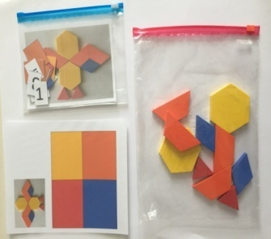
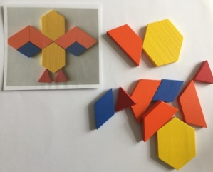
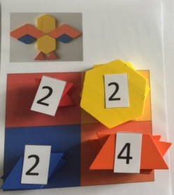
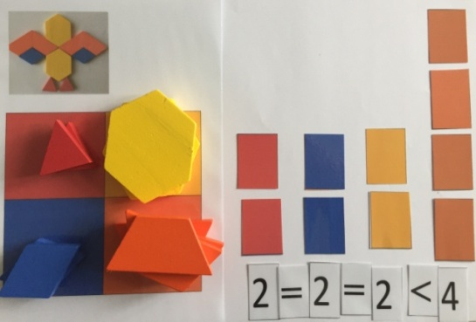
ANIMALS Numbers and value of the numbers
Data Manegemet
first
3-4 players in 7grups
JERNEJA BERGANT BELAJ,
Primary School VIČ, LJUBLJANA, SLOVENIJA
7 bags
The bag contains :
- painted wooden shapes
one table of colours
the picture of the animal
numbers and symbols
Counting and colour recognition
Comparing the numbers
Editing data
Working in groups
Divide 21 players in 7 grups
Give each grup one bag
One of the players opens the bag and divides the materials:
The first player makes an animal.
The second player puts the elements on right colours
The third player counts the elements.
All players ( or fourth player) make a column diagram and compare the numbers with each other, then they put
simbols between the numbers.
All of them play 7 times/ 7 different games .
In every game, they change the role in the group.

