Slide 1
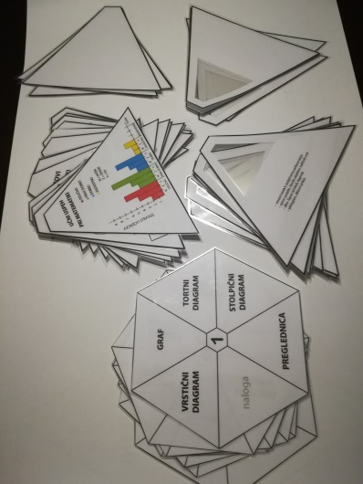
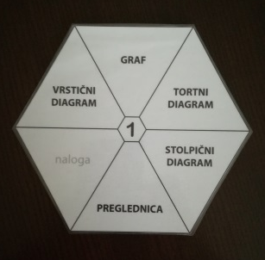
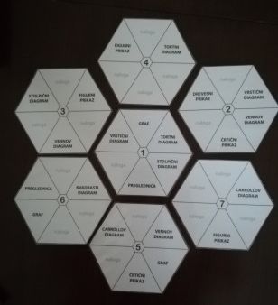
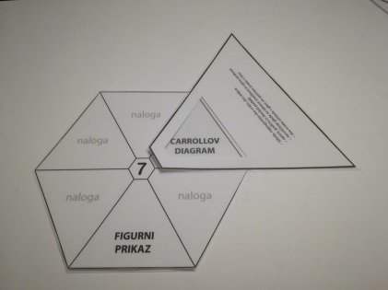
DATA HANDLING GAME
Data managment
3.-5.
1- 6
Romana Ferlič, OŠ Vič, Ljubljana, Slovenia
romana.ferlic@osvic.si
to get to know or to sum up how data can be displayed in various ways
to practice how to properly name different ways of data analysis (vocabulary)
to practise the skill of reading the data analysis and to reconstruct the situation of collecting the data
to provide opportunities for pupils to recognize the differences or/and resemblance in use and form of data handling
7 hexagrams (the basis – plan of the game)
19 cut out pieces of hexagram with presentations of different ways of data analysis (a task)
23 cut out pieces of hexagram with key information about individual data analysis
blank cut out pieces of hexagram (both samples)
lists of paper, pencils
1. At the beginning we put the hexagram No.1 on the table.
There is one word written on each part of hexagram which can represent
either a name of one of the various ways that data can be displayed or it is
a part with an assignment.
2. Place other six hexagrams around the hexagram No.1 .Look at the plan of the game!
The connection between hexagrams is made by creating pairs between a part with a name of data display and a part with graphical display of data (placed on a part named assignment.
3. A player, individually or in a grup (making a grup decision), looks up in a deck of cut out pieces for a piece which makes a pair with a part in hexagram (word or assignment);
A NAME OF one of DATA DISPLAY makes a pair with a LIST of KEY WORDS that represents the name written on the hexagram

Slide 2
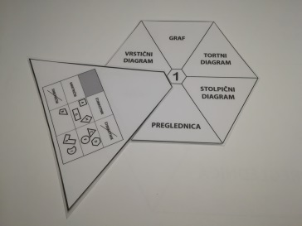
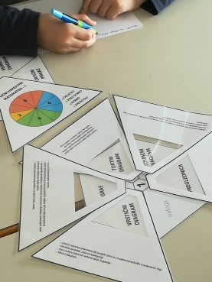
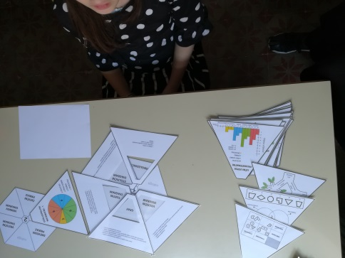
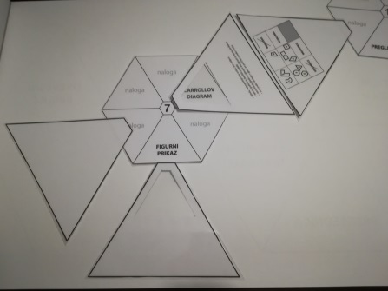
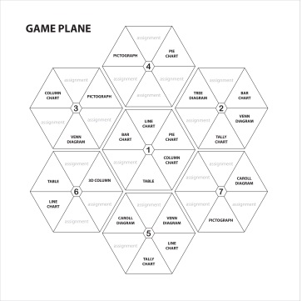
b) ASSIGNMENT (TASK) makes a pair with GRAPHICAL DISPLAY OF DATA
4. After finding a pair, a player covers a piece on hexagram with appropriate cut out piece.
In situation where there is a pair between WORD ASSIGNMENT (TASK) and GRAPHICAL DISPLAY OF DATA, a player must write down accordingly to the display:
A DESCRIPTION OF SITUATION
QUESTIONS ABOUT DATA
5. The goal is to cover up all the pieces in hexagram and complete all the assignments that are written on all seven hexagrams.
After finishing writing all assignments in hexagrams and finding out all of the key words for naming different charts, diagrames…, players can continue to play this game by writing down the key words and by drawing the graphic presentations of data analysis on the cut out blank parts of hexagram.
6. At the end, all completed hexagrams can be put together
in a shape of honeycomb.
It is also possible to achieve this effect at the very beggining
of this game. It is up to you to decide.

Slide 3
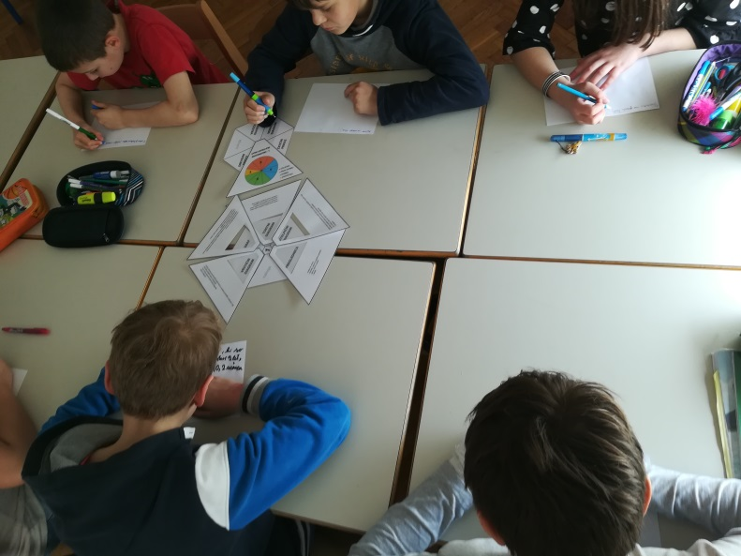
7. The winner can be an individual or a group. The success can be measured by the speed of finding pairs or writing the text for assignment. It can also be measured by the number of correct answers (in comparison to the answers of other players).

