Slide 1
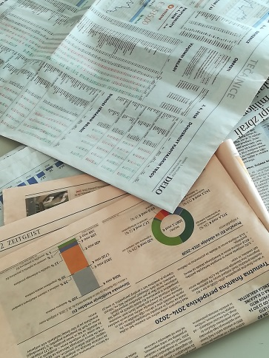
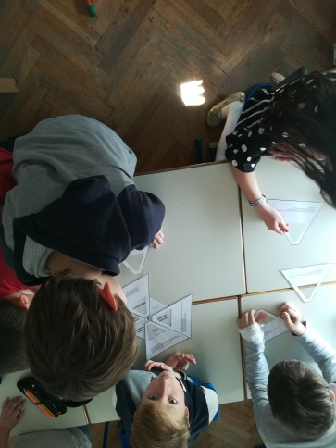
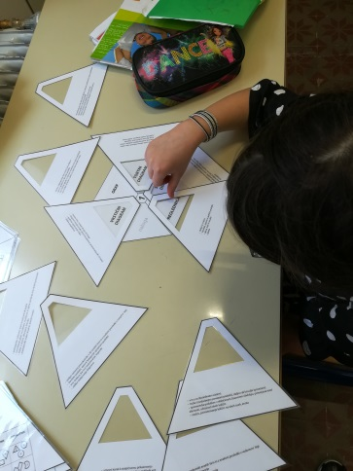
DATA HANDLING GAME
Data managment
3.- 5.
45 min
Romana Ferlič, OŠ Vič, Ljubljana, Slovenia
romana.ferlic@osvic.si
to get to know or to sum up how data can be displayed in various ways
to practice how to properly name different ways of data analysis (vocabulary)
to practise the skill of reading data analysis and to reconstruct the situation of collecting data
to provide opportunities for pupils to recognize the differences or/and resemblance in use and form of data handling
7 hexagrams (the basis – plan of the game)
19 cut out pieces of hexagram with presentations of different ways of data analysis (a task)
23 cut out pieces of hexagram with key information about individual data analysis
blank cut out pieces of hexagram (both samples)
lists of paper, pencils
1. INTRODUCTION
On the basis of different graphic displayes pupils make a conclusion about the subject of the lession – DATA ANALYSIS (data managment).
Teacher explains the objectives of the lesson.
2. ORGANIZING PUPILS
Dividing class into groups of 4, 5 or 6 pupils. It is possible to play it in pairs or even individually.
3. GAME RULES
Teacher introduces what kind of game this is, by whom and how it can be played, what is needed to play it, what is the goal of this game and shows up the key elements for making this game possible (the materials).

Slide 2
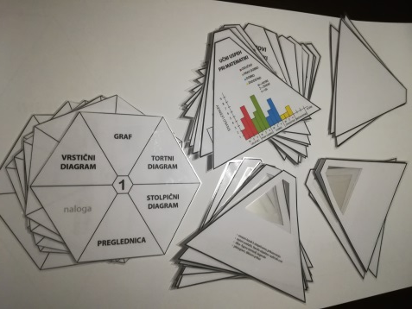
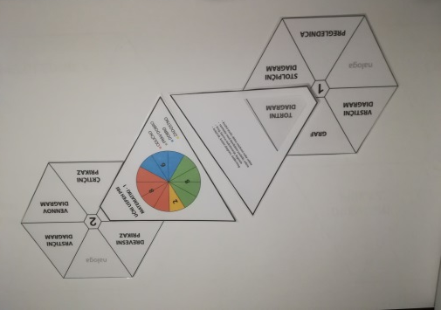
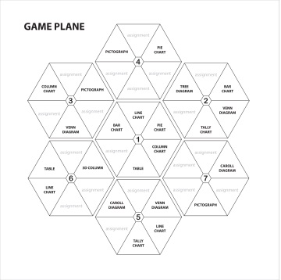
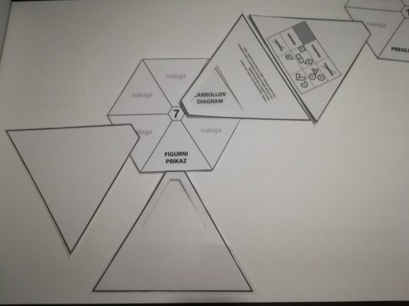
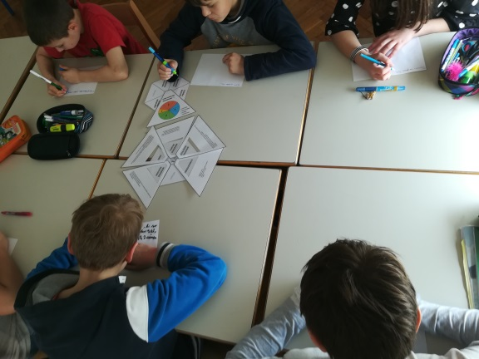
4. PLAYING THE GAME
Following the rules of the game.
After ending writing descriptions for all assignments in hexagrams and finding all the explanations of key words for naming different charts, diagrames…, players can continue to play this game by writing down the key words and by drawing the graphic presentations of data analysis in the cut out blank parts of hexagram.
5. THE ANALYSIS OF THE RESULTS / OF THE GAME
After reading various ways of displayed data, children can check their results in their own description of situations with their school mates (mistakes are corrected, missing information is improved)..

