Slide 1
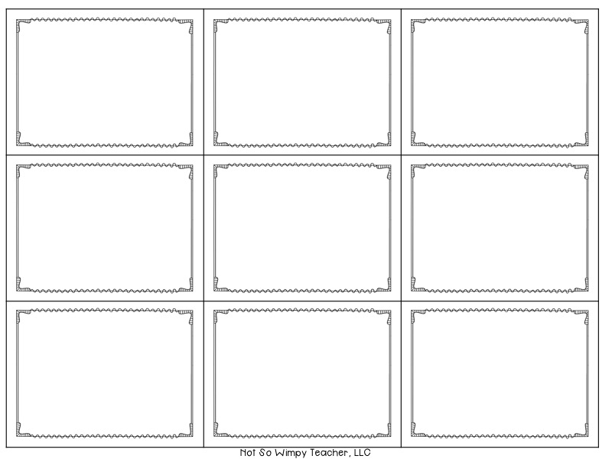
line
segment line
parallel lines
intersecting lines
perpendicular lines
ray
length of segment line
equal line segments
intersecting
point

Slide 2
side
vertices of 3D
edge of 3D
rectangular prism-cuboid
face of 3D
cube
sphere
cylinder
pyramid

Slide 3
ray point of origin
endpoints
triangle
rectangle
square
heksagon
circle
point
pentagon

Slide 4
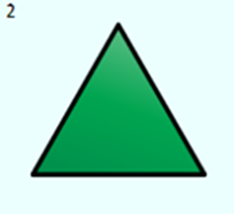
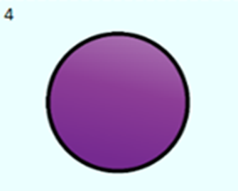

Slide 5
a
b
A
A B
a
P
b
B C
a b
a
b
A B

Slide 6
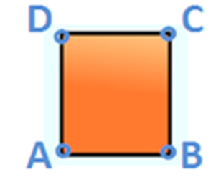

Slide 7
