Slide 1
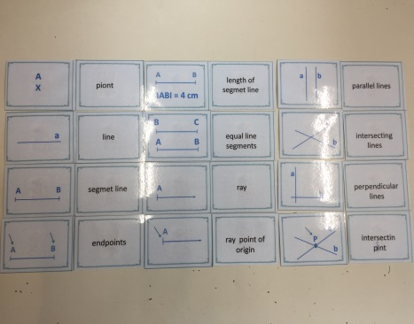
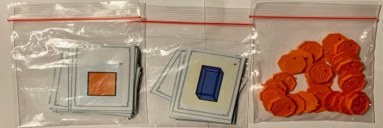
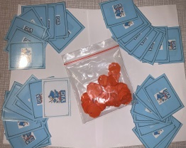
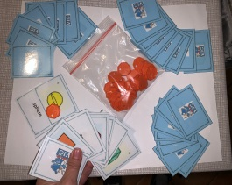
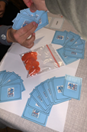
GEOMETRY Geometric terms
Geometry
fourth
4-5 players
JERNEJA BERGANT BELAJ,
Primary School VIČ, LJUBLJANA, SLOVENIJA
2 bags
the first bag contains: cards with geometry vocabulary: types of lines
the second bag contains: cards with geometry vocabulary: 2-dimensional figures and 3-dimensional figures
learning and revising geometry vocabulary and learning geometric terms
working in groups
8-10 players divided in 2 groups
give each group one bag
1. GROUP
A group should have 4-5 players.
One of the players opens the bag and puts the cards on the table:
The first player displays cards on the table. All of them observe words and pictures and try to find pairs. In that way they revise and learn geometric terms.
After finding pairs, the second player shuffles the cards and sets them facing down on the table (in the way like board game Memory (4x6)).
The third player starts Memory game. He reveals two cards, names them out loud and puts them back, if they are not a pair. If he finds a pair, he can take it. The players take turns and play Memory. When they pick up pairs, they must name geometric terms on cards.
The player, who takes a pair and puts it in front of him on the table, can get one token. The one who gets the highest amount of tokens, wins the game.
2. GROUP
A group should have 4-5 players.
Each group gets one game bag.
Players display cards on the table and revise and learn geometric terms.
Players search for pairs (pictures and words).
One player shuffles cards and deals the cards among the players. Players must hold cards in hands and hide them.
Players play game Black Peter. Each player holds 4 cards in hand, except one, who has 5 cards, so he begins to play. (One of them has one card with Black Peter).
He offers one card to the player on the left to choose it and pull it from his hand. They play in this way clockwise. When someone gets a pair, he names geometric terms and puts it on the table. The player who gets the highest number of pairs, and does not finish the game with Black Peter card, wins the game.

