Slide 1
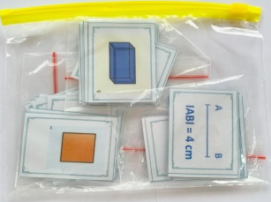
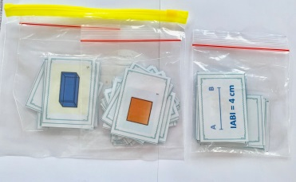
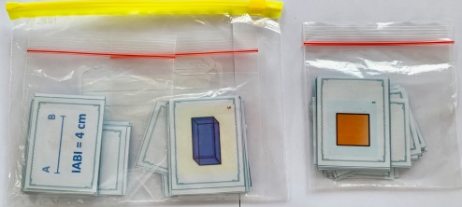
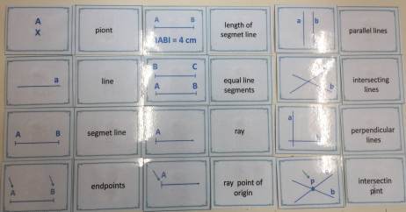
GEOMETRY Geometric terms
Geometry
fourth
one hour
JERNEJA BERGANT BELAJ,
Primary school : OŠ VIČ, LJUBLJANA, SLOVENIA
learning geometry vocabulary by repeating geometric terms
working in groups
2 bags
the first bag contains: cards with geometry vocabulary: types of lines
the second bag contains: cards with geometry vocabulary: 2-dimensional figures and
3-dimensional figures
1. INTRODUCTION
learning geometry vocabulary lines : https://www.youtube.com/watch?v=WsB7ACS1bzY
https://study.com/academy/lesson/basic-geometry-concepts-terms.html
https://study.com/academy/lesson/basic-geometry-rules-formulas.html
introduction of geometry vocabulary with game cards and ppt
2.THE MAIN PART OF THE LESSON
teacher reminds players TO HANDLE CAREFULLY with cards and at the end of the game to put all the cards in the bag.
1. group
divide students into 2 groups. Each group should have 4-5 players.
each group gets one game bag
players display cards on the table and revise geometric terms
players find pairs (pictures and words)
after finding pairs players shuffle cards and display them in memory shape
players play memory (4x6 cards). When they pick up pairs, they have to name geometric terms on cards
the player, who picks up a pair of cards, puts them in front of him on the table and gets one token. The one who gets the highest number of tokens, wins the game.

Slide 2
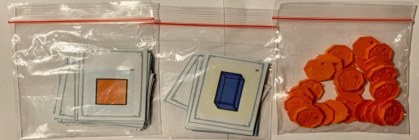
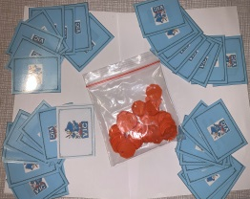
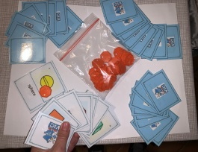
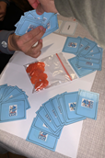
2. group
divide students into 2 groups. Each group should have 4-5 players.
each group gets one game bag
players display cards on the table and revise geometric terms
players complete pairs (pictures and words)
players shuffle cards and deal the cards among the players
players play the game Black Peter. When they get a pair, they name
geometric term and put it on the table. The student who gets the highest number of pairs,
wins the game.
3. CONCLUSION
TEACHER GIVES INSTRUCTIONS TO THE PLAYERS :
ALL THE GAME ELEMENTS MUST BE PUT CAREFULLY IN THE RIGHT BAGS. WHEN YOU ARE
FINISHED, PASS THE GAME TO THE OTHER GROUP NEARBY.
EACH GROUP PLAYS ONE GAME AND THEN THEY CHANGE THE BAGS.
IN EVERY GAME THEY MUST FOLLOW THE RULES IN THE GROUP.
For the teachears: The game can be played in the beginning of the lesson. Each student gets one card and they
can move around the classroom an find its pair.

